Slide 1

Algebra 1
Unit 2, Lesson 8 Adding, Subtracting, and Multiplying Polynomials Using More Than One Operation Volume 1, pg. 96

Slide 2


Benchmark
MA.912.AR.1.3
Add, subtract, and multiply polynomial expressions with rational number coefficients.
volume 1, pg. 96

Slide 3
Integrated Mathematical Thinking and Reasoning Standards
MA.K12.MTR.1.1 Actively participate in effortful learning both individually and collectively.
MA.K12.MTR.3.1 Complete tasks with mathematical fluency.
MA.K12.MTR.4.1 Engage in discussions that reflect on the mathematical thinking of self and others.
MA.K12.MTR.5.1 Use patterns and structure to help understand and connect mathematical concepts.
volume 1, pg. 96

Slide 4

Learning Targets
I can recognize adding, subtracting, or multiplying a polynomial will result in a polynomial.
I can add, subtract, and multiply polynomial expressions using more than one operation.
volume 1, pg. 96

Slide 5

Warm-Up
volume 1, pg. 97

Slide 6
2.8.1 Warm-Up: Electric Vehicle Technician
Ben Grandy went from studying landscape architecture to becoming an electric vehicle technician because of his passion for fighting climate change.
Ben shared that he believes communication is a very important skill, regardless of your job title in a company. Asking questions to have clarity on product needs, being able to improve products, and always striving to achieve better helps you to grow.
Describe a time when you sought to improve in something.
Describe a time when clear communication helped you improve.
volume 1, pg. 97
Notes:
Video Link: https://algebranation.wistia.com/medias/fi4fidi5y8

Slide 7

Collaboration
volume 1, pg. 97

Slide 8

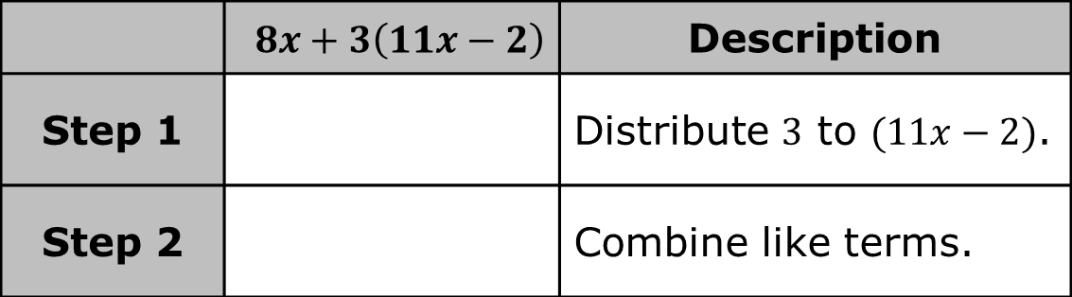
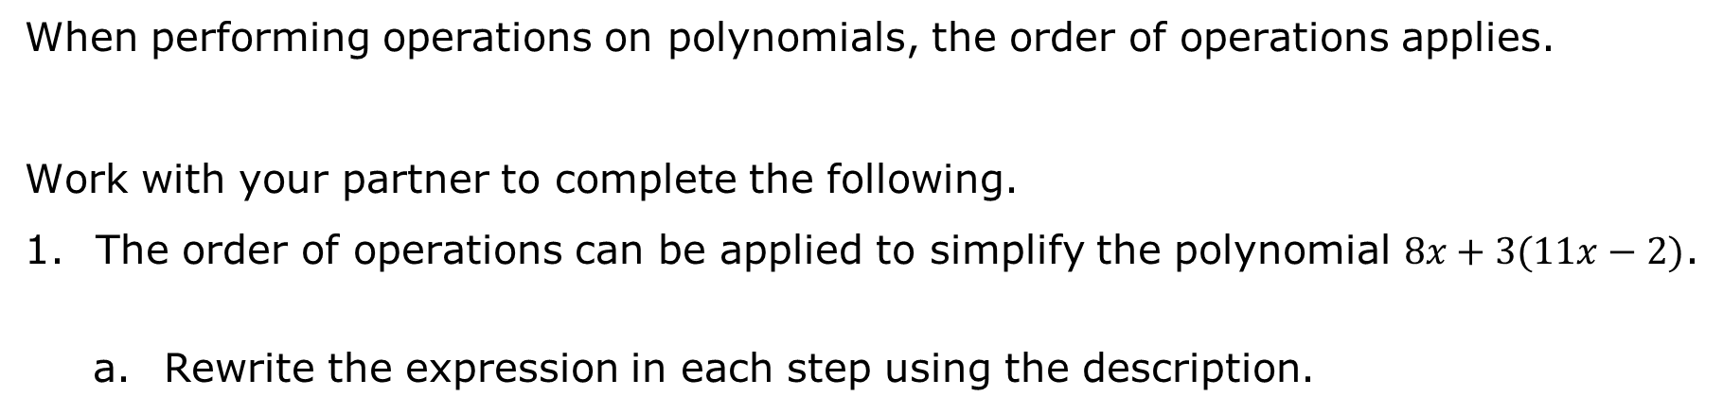
2.8.2 Collaboration: Adding and Subtracting Polynomials with Distribution
When performing operations on polynomials, the order of operations applies.
Work with your partner to complete the following.
The order of operations can be applied to simplify the polynomial $8x+3(11x−2)$.
Rewrite the expression in each step using the description.
 | $$8x+3\left(11x−2\right)$$ | Description
Step 1 |  | Distribute $3$ to $(11x−2)$.
Step 2 |  | Combine like terms.
volume 1, pg. 97

Slide 9
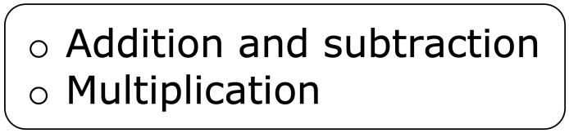
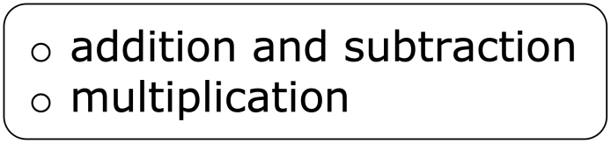
Complete the statement.
is done before
in the order of operations.
volume 1, pg. 97

Slide 10
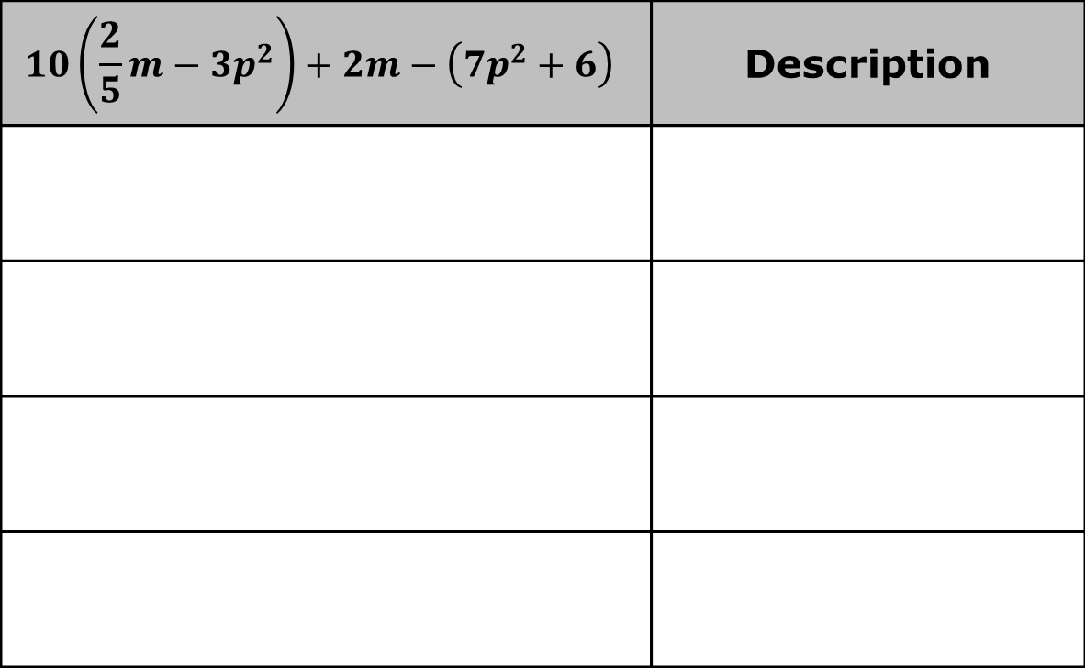
Use the order of operations to simplify the polynomial and describe each step you perform.
$$10\left(\frac{2}{5}m−3p^{2}\right)+2m−\left(7p^{2}+6\right)$$ | Description
volume 1, pg. 98

Slide 11
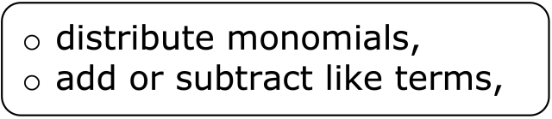
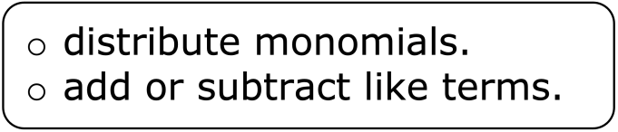
Complete the statement.
When adding and subtracting polynomials that include distribution, first then
volume 1, pg. 98

Slide 12

Activity
volume 1, pg. 98

Slide 13

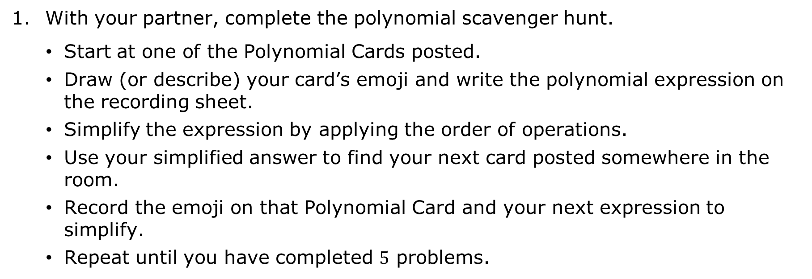
2.8.3 Activity: Polynomial Scavenger Hunt
With your partner, complete the polynomial scavenger hunt.
Start at one of the Polynomial Cards posted.
Draw (or describe) your card’s emoji and write the polynomial expression on the recording sheet.
Simplify the expression by applying the order of operations.
Use your simplified answer to find your next card posted somewhere in the room.
Record the emoji on that Polynomial Card and your next expression to simplify.
Repeat until you have completed $5$ problems.
volume 1, pg. 98

Slide 14
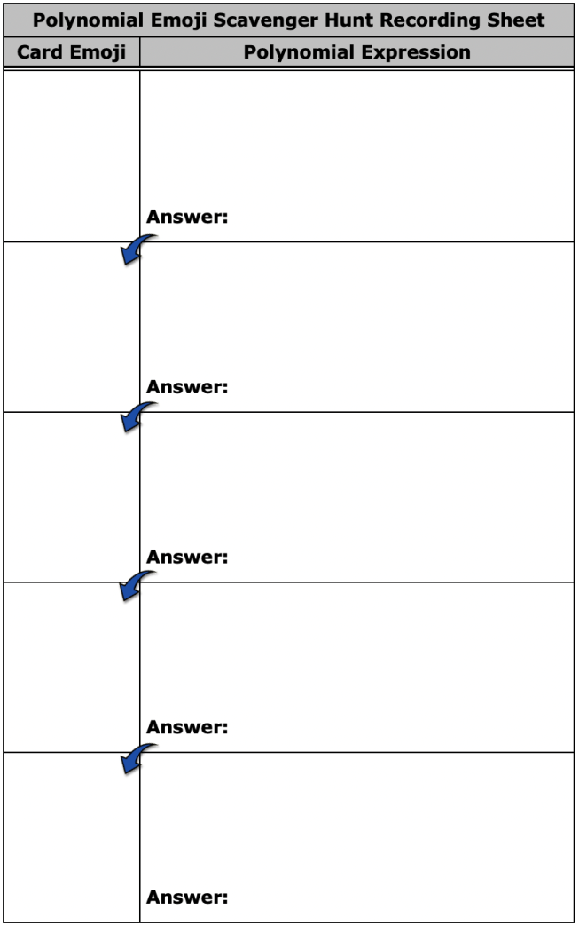
volume 1, pg. 99

Slide 15

The types of expressions you and your partner simplified in the emoji scavenger hunt were all polynomial expressions.
Review your answers. Discuss with your partner what the results have in common.
Complete the statement.
The result of adding, subtracting, and/or multiplying polynomials will result in a polynomial.
volume 1, pg. 99

Slide 16

Wrap-Up
volume 1, pg. 100

Slide 17
2.8.4 Wrap-Up: Growth Mindset
Check the description that matches your answer to each question for today’s lesson.
Mindset Question | Best Description for Me Today
Did I use the partner discussions as learning opportunities? | Never Sometimes Usually Always
Did I work on problems that challenged me? | Never Sometimes Usually Always
volume 1, pg. 100

Slide 18
Mindset Question | Best Description for Me Today
Did I use strategies to ‘un-stick’ myself when I found the problems difficult? | Never Sometimes Usually Always
Did I put as much effort as I possibly could into the problems? | Never Sometimes Usually Always
volume 1, pg. 100

